Slide 1

Happy Wednesday
Name tag
Check-in

Slide 2
iClicker Question
Categorical variable can have mean value
True
False

Slide 3

iClicker Question
R will not give you the mean for variables that you coded as 1 and 0.
True
False

Slide 4
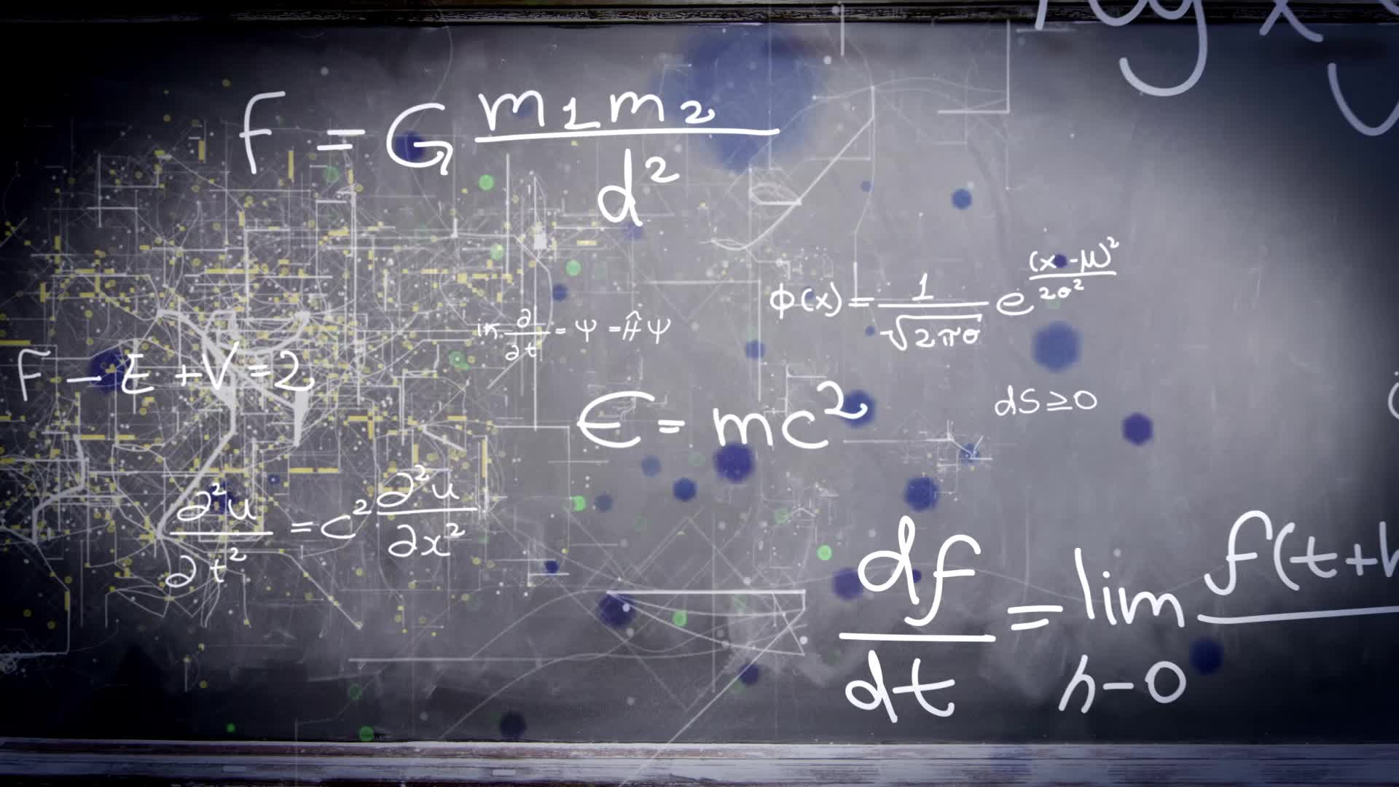
iClicker Question
The measure of central tendency for a categorical variable is
Mode
Mean

Slide 5
iClicker Question
The shape of the sampling distribution for any variable is
Normally distributed
Exponentially distributed

Slide 6




Data Analysis Plan

Slide 7
Level of Measurement for analysis variable
 | Nominal/ Ordinal (Categorical) | Interval/ Ratio (Continuous)
One variable (Descriptive RQ) | Percent, Median (ordinal), confidence interval | Average, confidence interval
Two variables (Difference RQ) | Cross-tabulation; two-way Chi-squared | Mean comparison; Independent t-test
Notes:
For difference RQ, you will choose the analysis method based on your analysis variable's level of measurement
The principle is to use the most succinct way to summarize the data
Interval and ratio can also use the same descriptive statistics as Nominal and Ordinal (with some transformation/ re-code in data analysis) but not vice versa.

Slide 8

Lab Session Cross-tabulation
Excel
R
Notes:
Go through descriptive statistics work sheet
Go through script_2 in R
Then go over the level of measurement sheet

Slide 9
Data Analysis Plan Template Assignment 6
 |  | Data Analysis Plans
(1) | (2) | (3) | (4) | (5) and (6)
Research Question | Type of Research Question* | Questionnaire Question | Level of Measurement** | Descriptive statistics or Statistical Test
* descriptive or differences research question
** nominal, ordinal, interval, or ratio
Notes:
Go to assignment 6
Show template
And go through example with students

Slide 10






QR Code

Slide 11
15-min Group Discussion
Data Analysis Plan

Slide 12
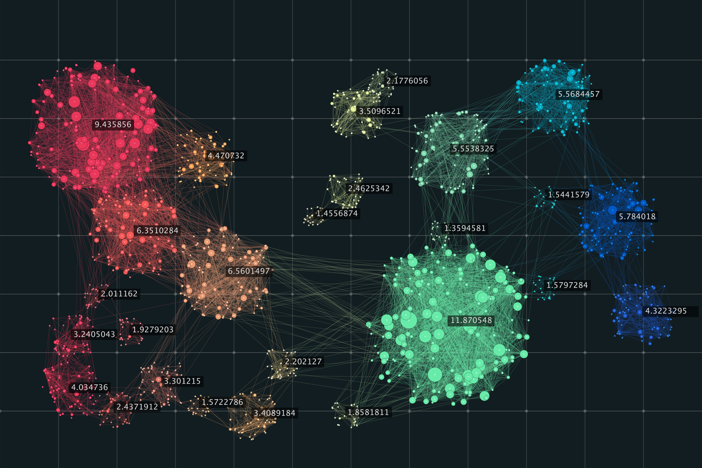
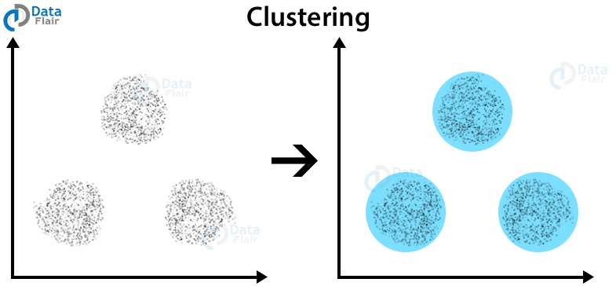
5-min snippet
Notes:
http://www.netlogoweb.org/launch#http://www.netlogoweb.org/assets/modelslib/Sample%20Models/Computer%20Science/K-Means%20Clustering.nlogo
Often, when we have data about a large set of objects, we want to identify groups of similar objects within that set. For example, if we have many news articles, we may want to identify groups of articles that all have the same topic. In statistics, this task is called “cluster analysis”, or “clustering”.
This model shows the k-means clustering algorithm. a simple, but often effective approach to clustering. In this model, the k-means clustering algorithm is used to identify clusters of points on a plane. In the general case, you can represent your data objects as vectors of numbers, where each number represents a feature of the object.
The model is initialized by creating a specific number of clusters (NUM-CLUSTERS). In a real-world application, this number of clusters would be unknown. The algorithm is designed to find the clusters, and the user selects a guess, NUM-CENTROIDS, which tells the algorithm, how many clusters to search for. You can search for different numbers of clusters till you find one that best characterizes your data.
The result of the algorithm is a set of NUM-CENTROIDS points, (each point is called a centroid), each of which is located at the average position of a corresponding cluster. The “k” in k-mean clustering refers to the guess at how many centroids to search for.
The purpose of the model is to allow you to see how the number of data points, clusters, and centroids interact, and how the algorithm can often find many different sets of clusters for the same dataset.
How it works
The algorithm works by finding the average position of the elements in NUM-CENTROIDS different clusters. It starts by simply guessing an average position for each of the NUM-CENTROIDS clusters, and then improves these guesses as it goes on.
When the model is set up, two things happen: First, NUM-DATA-POINTS data points are generated and shown in the view. Second, NUM-CENTROIDS centroids are generated and moved to a randomly selected data point. This randomly selected point is the initial guess for each centroid.
Each tick, the model performs two steps: 1. ASSIGN POINTS: all data points assign themselves to their closest centroid, taking on its color. 2. UPDATE CENTROIDS: all centroids move to the average position of the points assigned to it.
By iterating these steps a few times, the model is usually able to identify clusters in the dataset.

